Slide 1
British Airways
Web scraping to gain company insights
By Ashish Shinde
https://github.com/AshishShinde03/BritishAirwaysProject.git

Slide 2
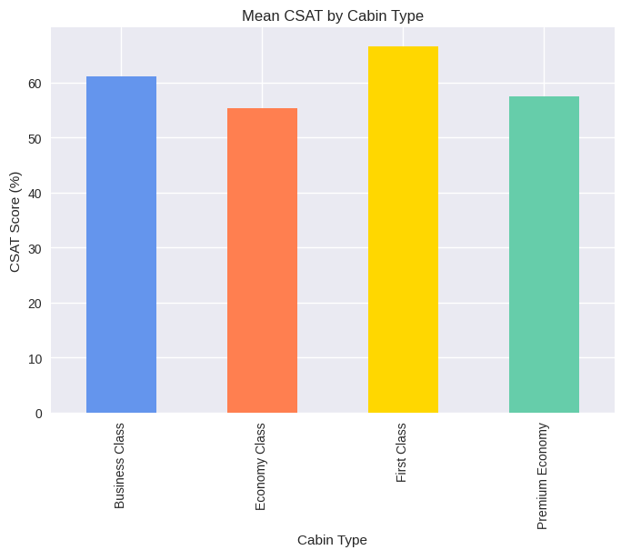
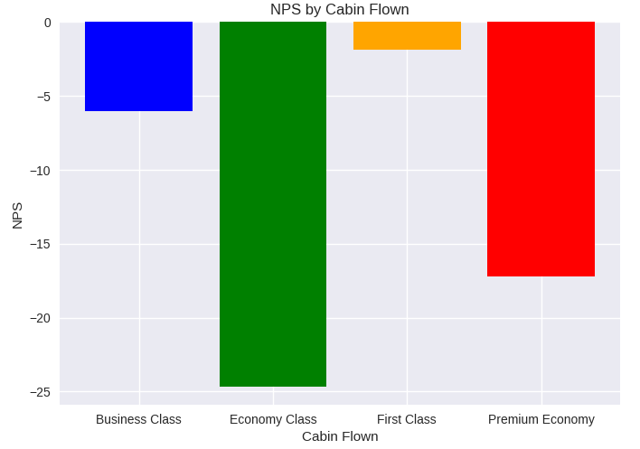
CSAT (Customer Satisfaction) NPS (Net Promoter Score)
Overall Customer Satisfaction Rate 58%
Cabin with highest Customer satisfaction – First Class
Cabin with lowest Customer
satisfaction – Economy Class
Cabin with highest NPS – First Class
Cabin with lowest NPS – Economy Class

Slide 3
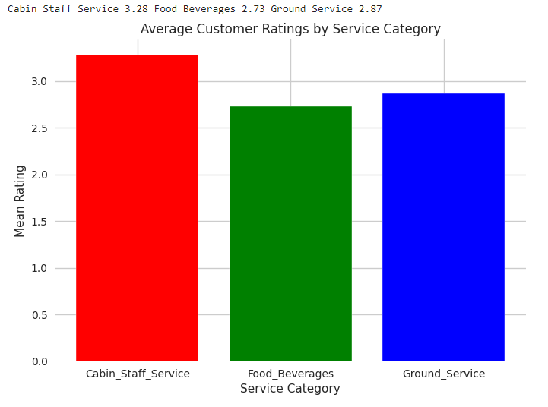
Analysis of Services provided
Service with best Customer Rating of Average 3.28 is Cabin Staff Service
Service with worst Customer Rating of Average 2.73 is Food and Beverages

Slide 4
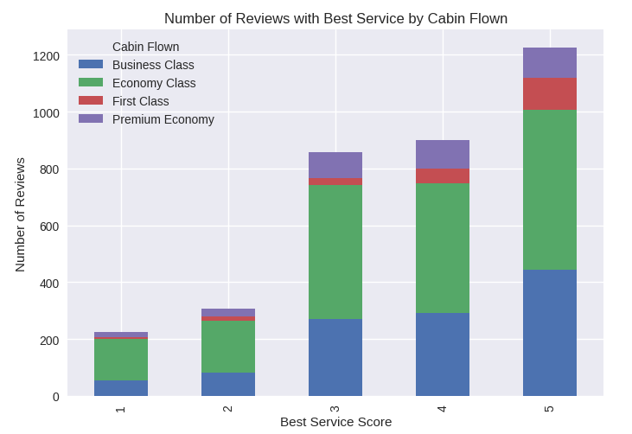
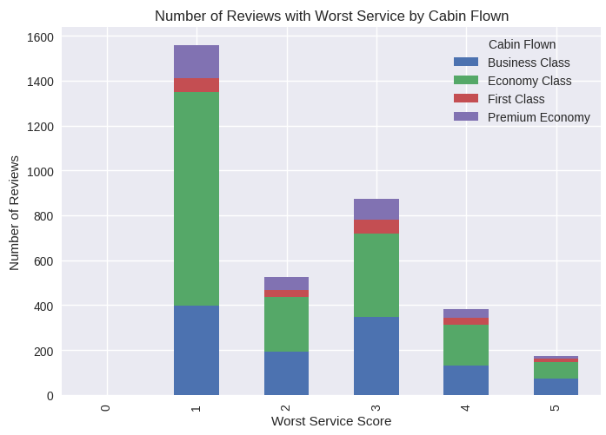
Analysis of services by Cabin type

Slide 5
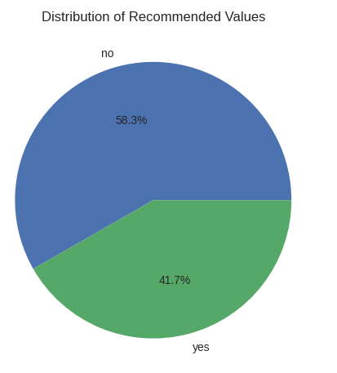
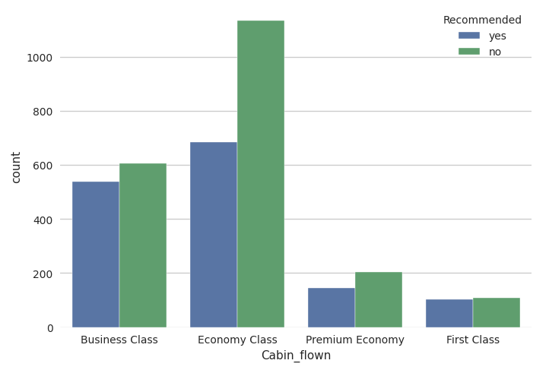
Customer Review Analysis
Almost 58% of the Customers did not recommend to travel by British Airways
Above graph shows the Customer recommendation by Cabin type and Economy Class has the worst impact on the recommendation and requires attention

Slide 6
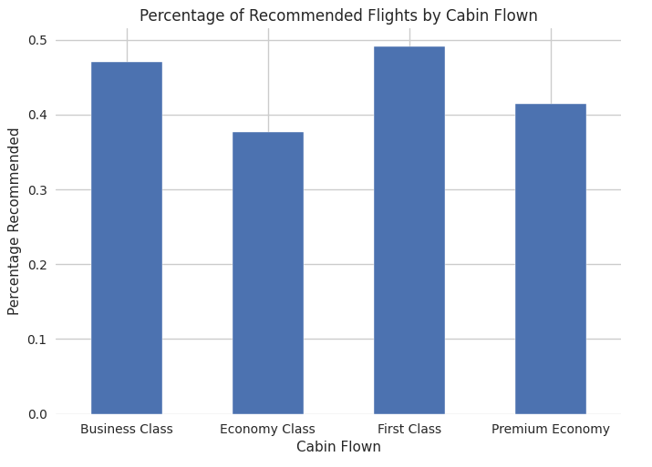
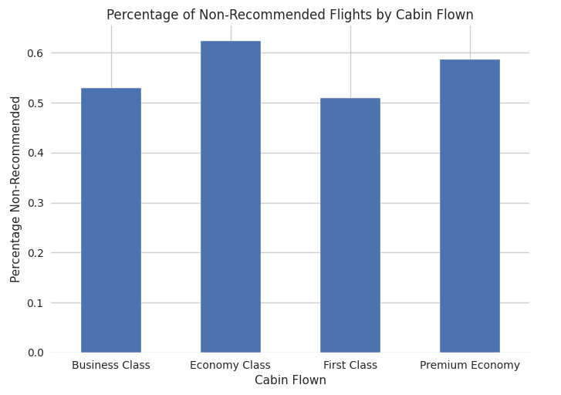
Customer Review Analysis
Cabin with highest & lowest recommendation rate is First Class and Economy class respectively
Cabin with highest non-recommended rate is Economy class followed by Premium Economy Class

Slide 7
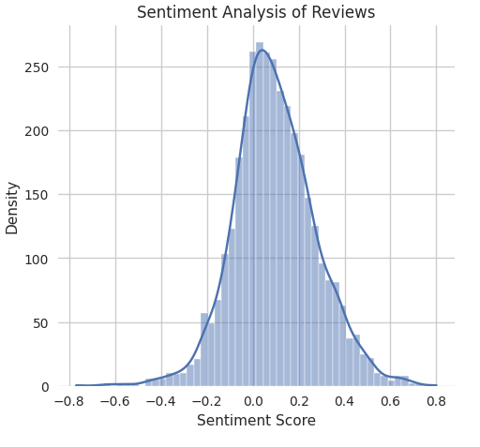
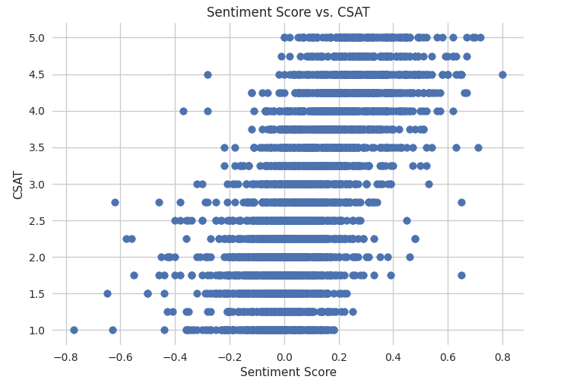
Customer Reviews Sentiment Analysis
Above graph is right skewed which indicated the overall customer reviews are positive
Above graph shows the relation between CSAT score and Customer Reviews
Higher the CSAT score positive are the reviews

Slide 8
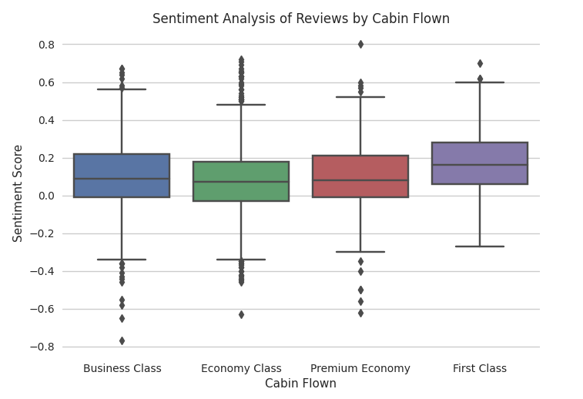
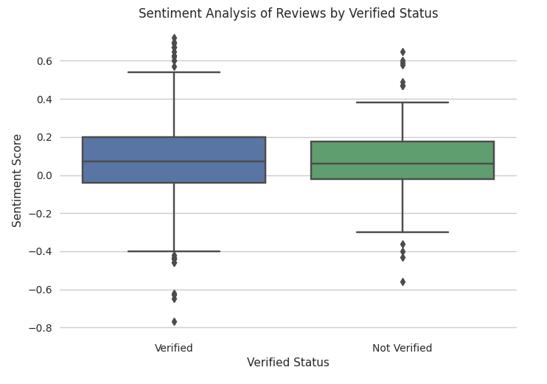
Sentiment Analysis by Cabin type Sentiment Analysis by type of Reviews
Based on above graph we can see that First Class Customers have more positive revies compared with other three cabins
Above graph shows that there is no significant effect of verified and non-verified reviews. Hence, we can consider non-verified reviews as well for analysis

Slide 9
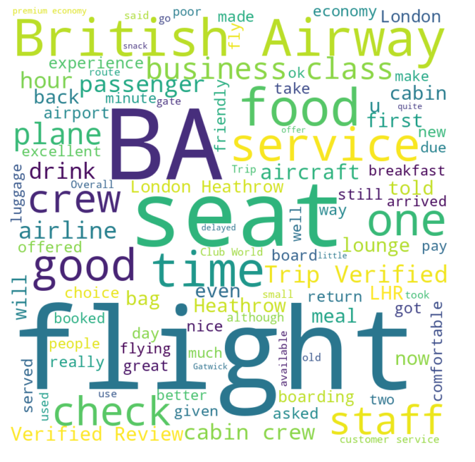
Word Cloud

Slide 10
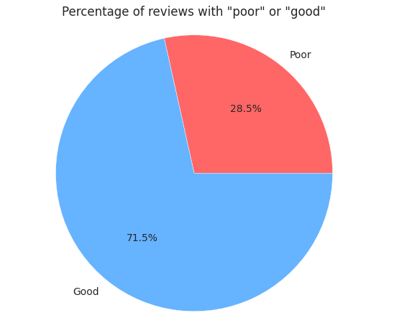
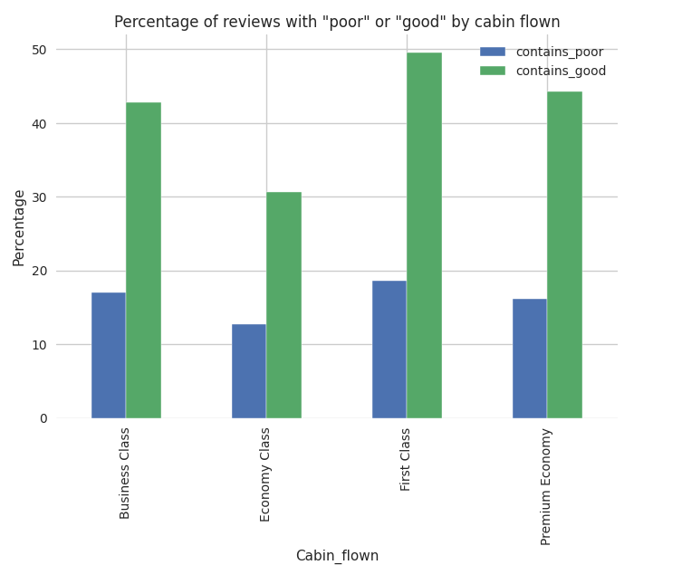
Word “Good” and “Poor” usage across all reviews Percentage of word “Good” and “Poor” usage by Cabin type

Slide 11
Conclusion
To increase the recommendation, British Airways needs to increase the quality of food and beverages services particularly in the Economy Cabin
A linear relationship between CSAT (customer satisfaction) and reviews means that there is a direct correlation between the two variables. In other words, as CSAT ratings increase or decrease, the sentiment expressed in the reviews also tends to increase or decrease correspondingly. This suggests that CSAT ratings can be used as a predictor of the sentiment expressed in customer reviews
Verified and Non-Verified reviews show similar pattern so we can consider all the reviews and don’t need to eliminate non-verified reviews

